Slide 1
Working with Streams and Lambda Expressions in Java

Slide 2


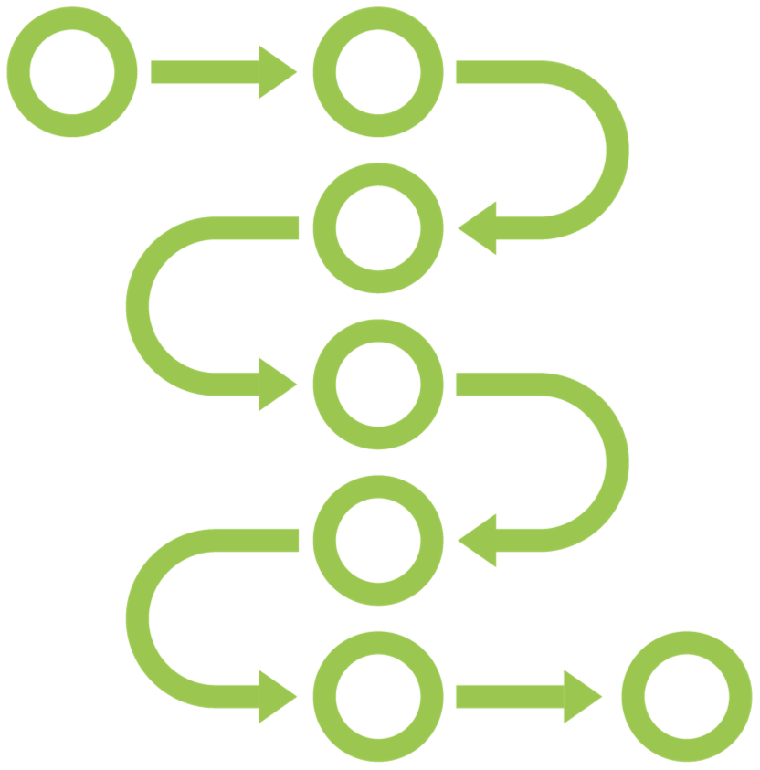
Working with Streams and Lambda Expressions
Lambda Expressions
Functional Interfaces
Streams

Slide 3



Developer Certification Exam Skills
Implement functional interfaces using lambda expressions, including interfaces from the java.util.function package.
Use Java streams to filter, transform and process data.
Perform decomposition and reduction, including grouping and partitioning on sequential and parallel streams.

Slide 4

Working with the Exercises
Download examples and exercises from the Git Hub repository.
Java Development Kit for Java SE 11
https://oracle.com/javase
https://adoptopenjdk.net
IDE – IntelliJ IDEA
https://jetbrains.com

Slide 5
Lambda Expressions – First Look

Slide 6
What Is a Lambda Expression?
A lambda expression is an anonymous method
Functional programming: Passing code as data

Slide 7
Functional Interfaces – First Look

Slide 8
Functional Interfaces
new Comparator<Product> { @Override
public int compare(Product p1, Product p2) { return p1.getPrice().compareTo(p2.getPrice());
}
}
(p1, p2) -> p1.getPrice().compareTo(p2.getPrice())
interface Comparator<T> { int compare(T o1, T o2);
}

Slide 9
Functional Interfaces
interface Comparator<T> { int compare(T o1, T o2);
}
interface Runnable { void run();
}
interface FileFilter { boolean accept(File f);
}
interface ActionListener {
void actionPerformed(ActionEvent e);
}

Slide 10
Lambda Expressions and Functional Interfaces
implements
Lambda Expression
Functional Interface
Standard functional interfaces in package java.util.function

Slide 11
Syntax of Lambda Expressions

Slide 12
Syntax of Lambda Expressions
public int compare(Product p1, Product p2) { return p1.getPrice().compareTo(p2.getPrice());
}
public int compare
public
public int
public int compare(Product p1, Product p2)
Access specifier Return type Name Parameter list
Body
(Product p1, Product p2) -> p1.getPrice().compareTo(p2.getPrice())
(p1, p2)
(p1, p2) ->
(p1, p2) -> p1.getPrice().compareTo(p2.getPrice())
Parameter list Arrow Body

Slide 13
Syntax of Lambda Expressions
Runnable runnable = () -> System.out.println(“Hello World”);
No parameters
FileFilter filter = file -> file.isHidden();
Single parameter

Slide 14
Syntax of Lambda Expressions
public int compare(Product p1, Product p2) { return p1.getPrice().compareTo(p2.getPrice());
}
(p1, p2) -> {
return p1.getPrice().compareTo(p2.getPrice());
}
(p1, p2) -> p1.getPrice().compareTo(p2.getPrice())

Slide 15
Syntax of Lambda Expressions
parameters
->
body
Parameter types are optional
No parameters: empty parentheses
Single parameter: parentheses are optional
Block or single expression

Slide 16
Capturing Variables in Lambda Expressions

Slide 17
Interaction of Lambda Expressions
with Enclosing Code

Slide 18
The Meaning of “this” in an Anonymous Class
public class Example {
public void printMessage() {
Runnable runnable = new Runnable() { private String message = “Hello World”;
public void run() { System.out.println(this.message);
}
};
new Thread(runnable).start();
}
}

Slide 19
The Meaning of “this” in a Lambda Expression
public class Example {
private String message = “Hello World”;
public void printMessage() { Runnable runnable =
() -> System.out.println(this.message);
new Thread(runnable).start();
}
}

Slide 20
Working with Exceptions in Lambda Expressions

Slide 21
Method References

Slide 22
Four Types of Method References
ClassName :: methodName
objectRef :: methodName ClassName :: methodName ClassName :: new
Static method
Instance method of a specific object
Instance method not of a specific object
Constructor

Slide 23
Summary of Lambda Expressions

Slide 24


Lambda Expressions and Functional Interfaces
A lambda expression is an anonymous method
A lambda expression implements a functional interface
A functional interface has a single abstract method

Slide 25
Syntax of Lambda Expressions
(p1, p2) -> p1.getPrice().compareTo(p2.getPrice())
(Product p1, Product p2) -> {
return p1.getPrice().compareTo(p2.getPrice());
}
(p1, p2) -> {
return p1.getPrice().compareTo(p2.getPrice());
}
Runnable runnable = () -> System.out.println(“Hello World”);
FileFilter filter = file -> file.isHidden();

Slide 26





Lambda Expressions
Captured local variables must be effectively final
Avoid side effects in lambda expressions
this and super have the same meaning as in surrounding code Dealing with exceptions can be inconvenient
Use a method reference instead of a lambda expression

Slide 27
Working with the Exercises
Take a look at the example code
Work with the exercises

Slide 28
Up Next:
Working with Functional Interfaces

